Slide 1
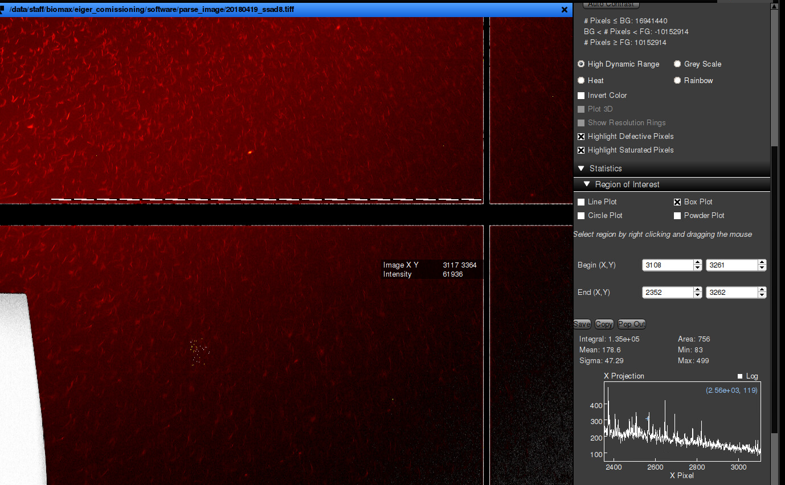
Biased count at the edges of module
Due to rounding after flatfield correction
20180419_ssad8_7keV.tiff
summed image of 3600 frames, 0.01s exp, @7keV
Each point is the mean counts of X(2352-3108) on the row of Y Pixel, as shown of the dashed box in the left figure.

